Slide 1


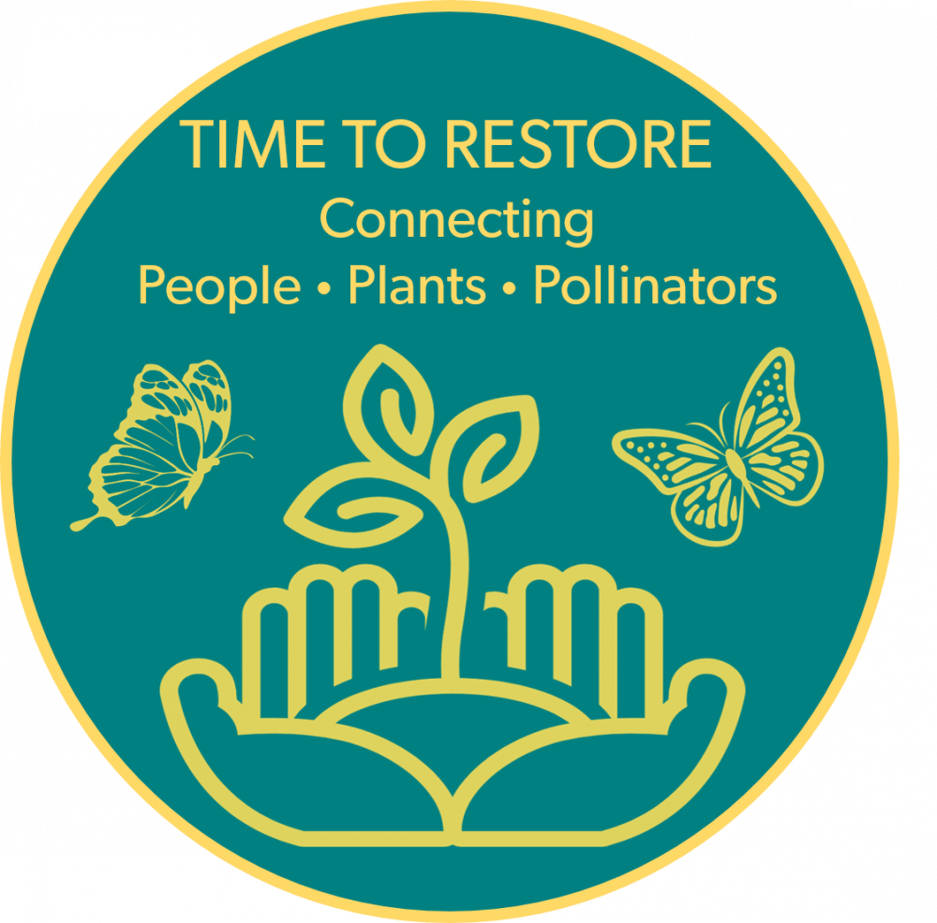

Pollinator Restoration and Nectar Availability in the South-Central Region
Hayley Limes
Notes:
Hi, I’m Hayley :D

Slide 2
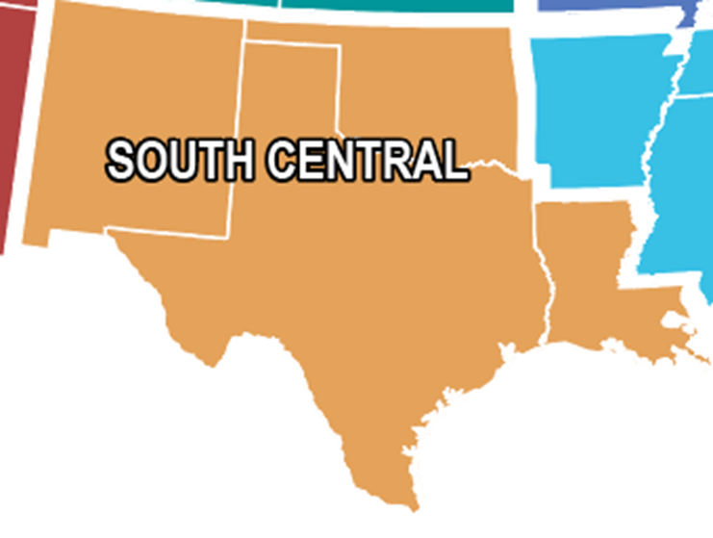
Our Team
Erin Posthumus, USA National Phenology Network
Alyssa Rosemartin, USA National Phenology Network
Hayley Limes, USA National Phenology Network
Oklahoma:
Jane Breckinridge, Tribal Alliance for Pollinators
April Taylor, South Central Climate Adaptation Science Center
Louisiana:
Gail Bishop, Gulf Coast Phenology Trail
Sue Wilder, Gulf Coast Phenology Trail
New Mexico:
Kim Eichhorst, Bosque Ecosystem Monitoring Program
Notes:
Look at our Awesome Team!

Slide 3
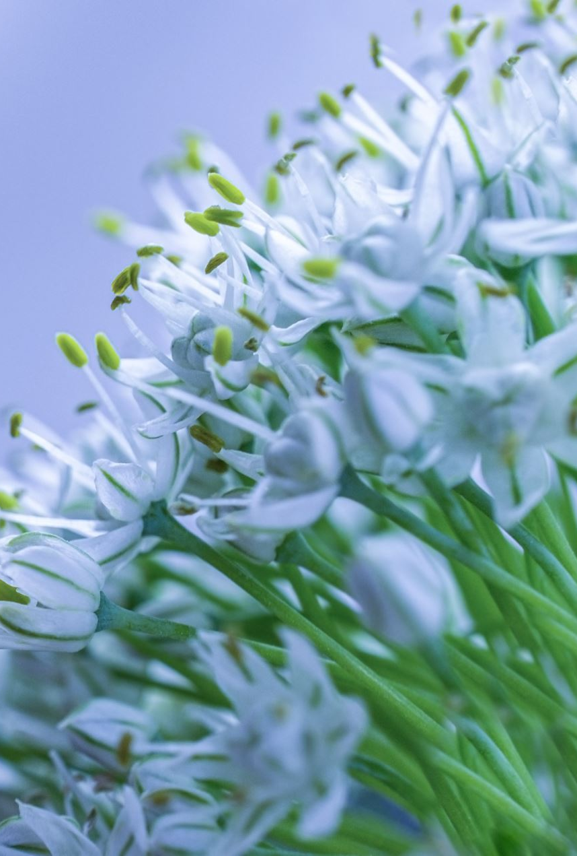
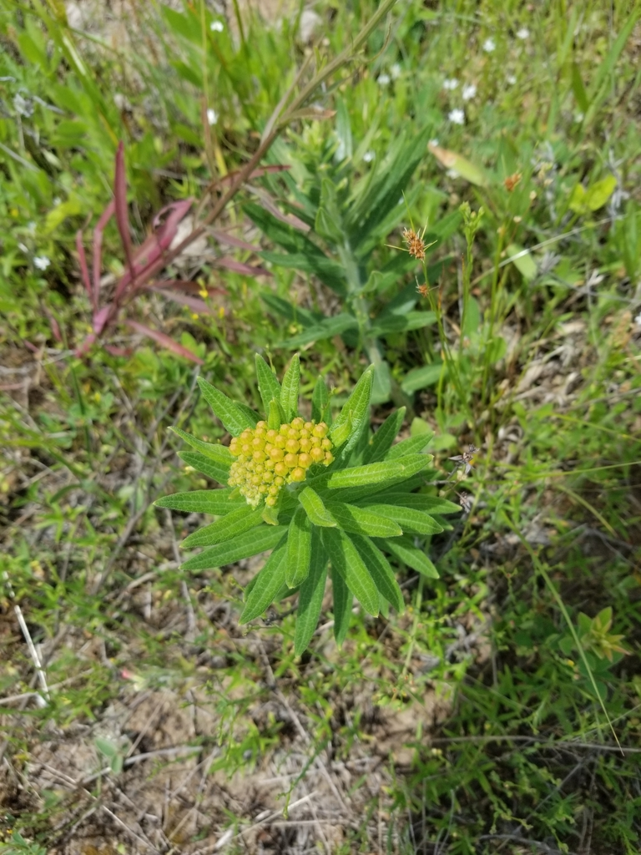
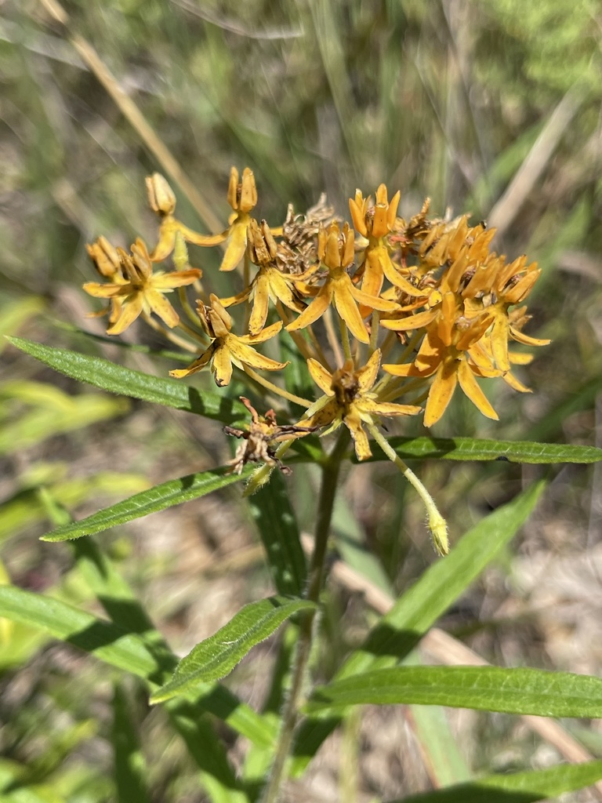
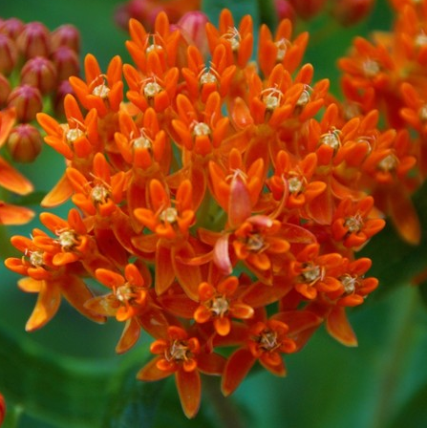
Time To Restore: Connecting People, Plants, and Pollinators
Goals
To aid in pollinator restoration by providing planters with knowledge of plant lifecycle events
EX: When does flowering start (onset), When is the most nectar available (peak), how long does flowering last (duration)?
<- Duration ->
Onset
End Date
Peak
April
May
June
July
August
Notes:
Remember, you are creating a process for when we get the data

Slide 4
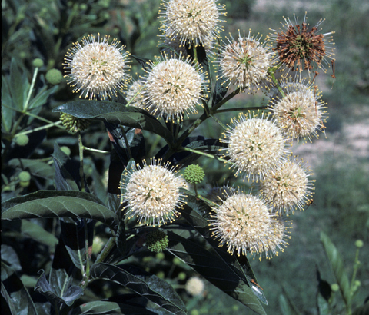
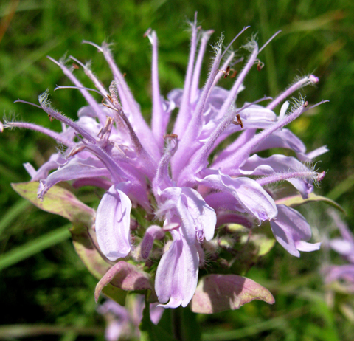
Stakeholder Workshops and Data Gathering
In the Fall and Winter of 2021 workshops with stakeholders in pollinator restoration were held in New Mexico, Louisiana, Oklahoma (with Texas members joining whichever they were able)
These provided a list of plant species we wanted to prioritize for current study and future data collection
We have used data from the USA National Phenology Network’s Database Nature’s Notebook as well as the I-Naturalist app
Using these we have begun to look at onset and duration of flowering and fruiting for our plant species
Harry Cliffe via Wildflower.org
Thomas L Muller via Wildflower.org

Slide 5
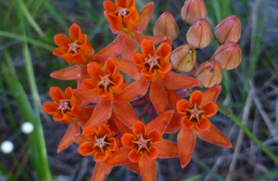
Intensity Data: How do we describe plant flowering and fruiting?
Intensity Data: Data on how much of a plant is flowering or fruiting over its lifecycle
For Example:
Around 15 flowers on this milkweed
Around 50% are open
There are around 8 open flowers
How is it useful to describe Intensity?

Slide 6
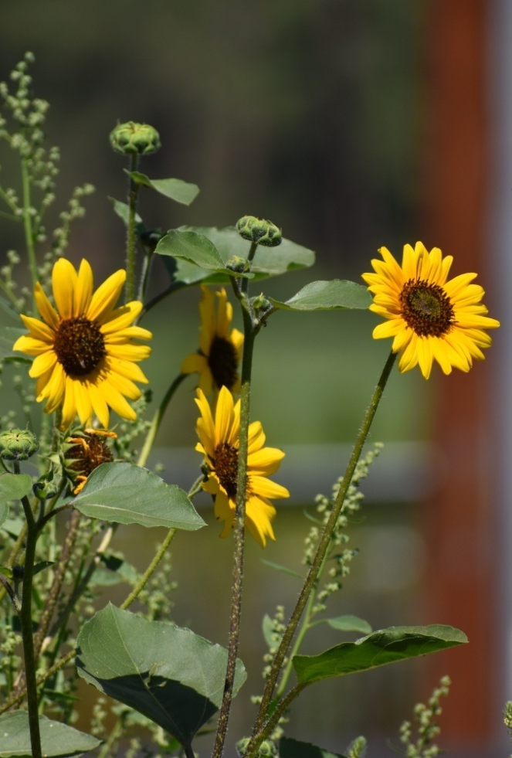
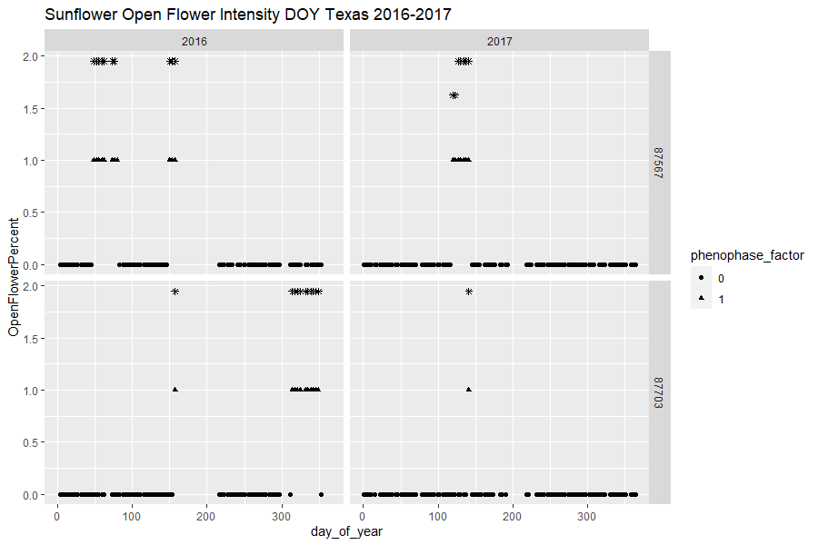
Data from the South-Central Region
Intensity
Day of Year
Notes:
Remember, you are creating a process for when we get the data

Slide 7
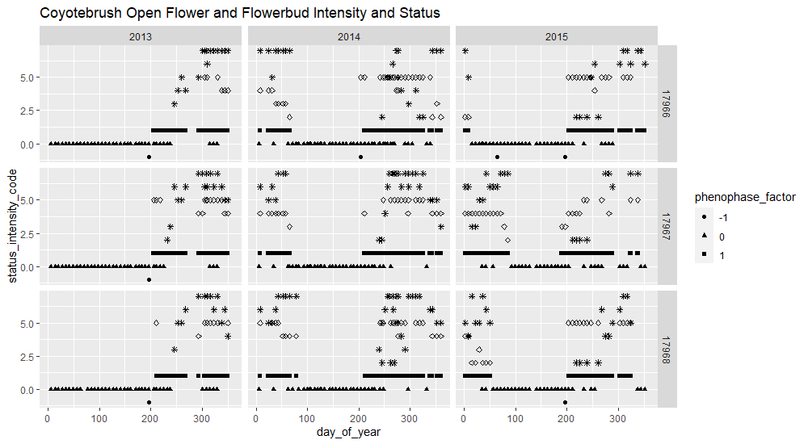
Intensity Data: How do use intensity data to investigate phenology and peak flowering?
Santa Monica Mountains Coyotebrush Open Flowers and Flower buds Intensity and Status
We want to know:
When are plants producing the most nectar? Aka What is the peak intensity?
Are there some species with multiple peaks?
How do we measure a “peak” in flowering or fruiting? Should it be a single date? A range? How do our data inform our characterization?
Individual 1
Status Code (1-6)
Individual 2
Individual 3
Day of Year
Notes:
Conceptual curve

Slide 8
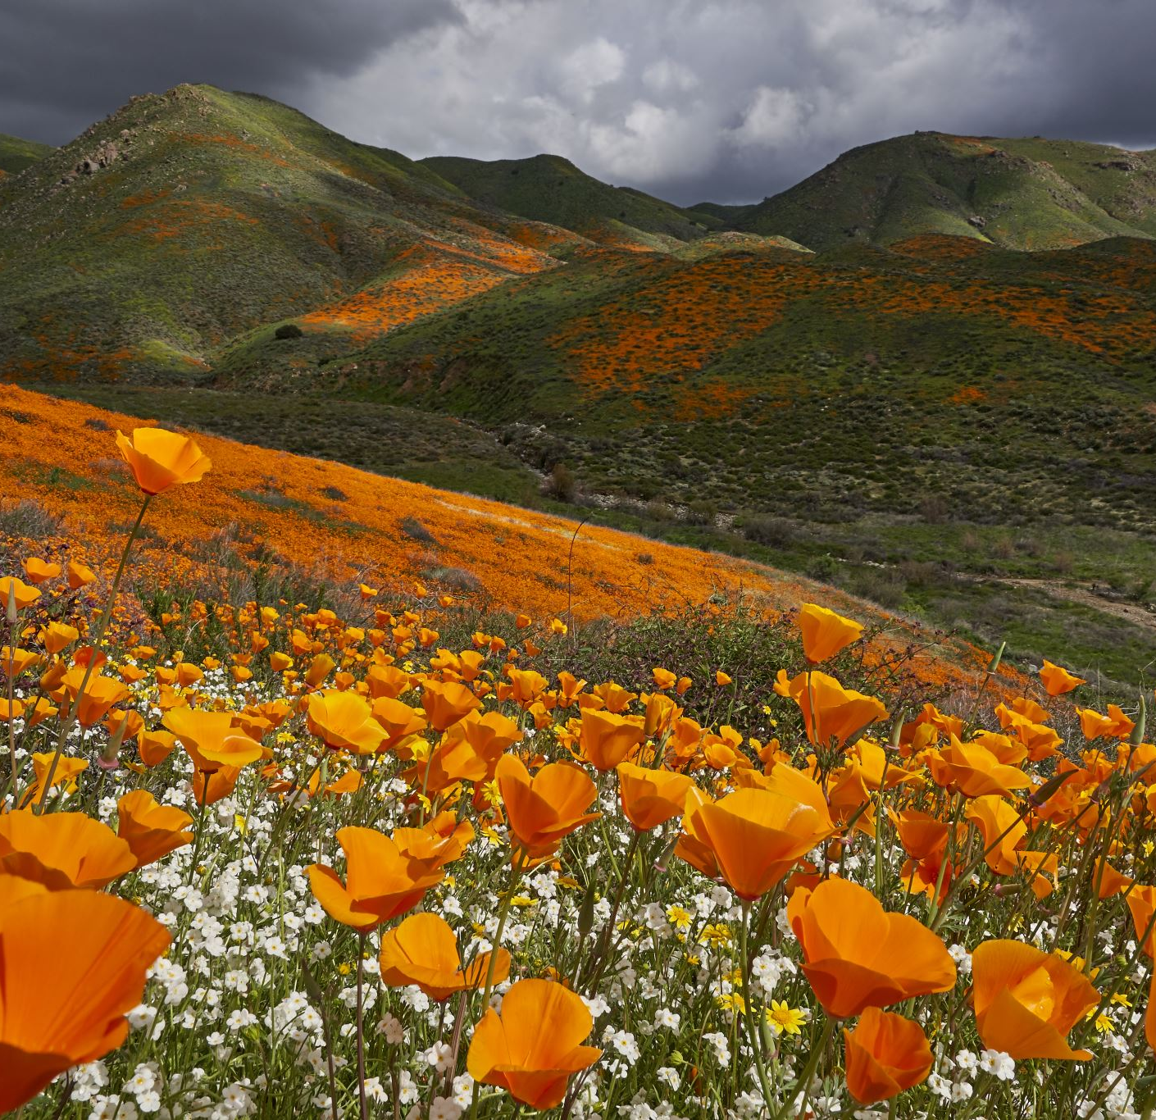
Future Directions: Climate Data
Once we can determine the peak, we can begin to look for climate drivers that affect it
This is also true for the onset and duration of flowering and fruiting
This will help those planting for pollinator restoration choose plants that will continue to be productive in shifting climates

Slide 9
The South Central Climate Adaptation Science Center and the Arizona Space Grant Consortium for their generous funding and Alyssa Rosemartin and Erin Posthumus for their guidance
Thank You

